Slide 1


Safety Training 101
Notes:
Welcome to Recycle Your Batteries, Canada! Safety Training 101.
In just a few minutes, you’ll learn simple steps to identify, handle, and ship batteries safely to Protect What Matters and Be Battery Safe.

Slide 2
Welcome to Recycle Your Batteries, Canada! Training Overview
Objectives
You’ll Learn
Identify and responsibly manage
end-of-life batteries.
Understand program requirements for safe battery shipping.
Comply with Transport Canada (TC) regulations.
About Recycle Your Batteries, Canada!, Batteries 101, and program basics.
How to safely handle, prepare, and ship batteries.
What marketing and program resources are available, and how to access.
Notes:
Today’s training will help you manage end-of-life batteries safely and responsibly. We’ll cover battery identification and program requirements to ensure compliance with Transport Canada regulations. You’ll also learn about the Recycle Your Batteries, Canada! program and the resources available to support you. Together, these steps work to protect you throughout the battery recycling process from start to finish.

Slide 3



About the Program
WHAT IS IT?
Powered by the non-profit Call2Recycle, Recycle Your Batteries, Canada! is the country’s largest household battery collection and recycling program, with nearly 15,000 drop-off locations nationwide.
HOW DOES IT WORK?
Funded by producers (manufacturers, retailers, importers, distributors) to ensure the batteries they produce and/or sell are responsibly recycled when they reach their end of life.
WHAT IMPACT HAS IT HAD?
Since its inception, the program has recycled over 50 million kilograms of batteries, keeping them out of landfills and recovering valuable materials used to create new batteries and other products.
Notes:
For background, here is a quick snapshot on Call2Recycle and our Recycle Your Batteries, Canada! program: what it is, how it works, and the difference we’re making together.

Slide 4
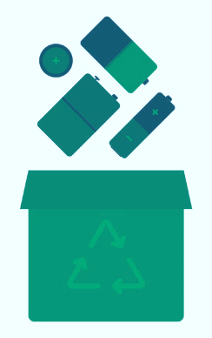



Protect What Matters. Be Battery Safe.
Mishandling or throwing away batteries can cause fires, putting people, property, and the environment at risk.
To keep battery recycling safe, we all have a role to play.
Training = Prevention. Together, we can prevent these safety risks:
Thermal Events
Improper Shipping of
DDR Batteries
Jostling of Batteries
Unprotected batteries can cause fires.
Damaged/Defective/Recalled batteries cannot go into any Call2Recycle collection container. Use special packaging.
Movement during transport can cause unintentional damage.
Notes:
Preparation is key to preventing safety incidents. Here are a few examples of what we can avoid by working together.

Slide 5
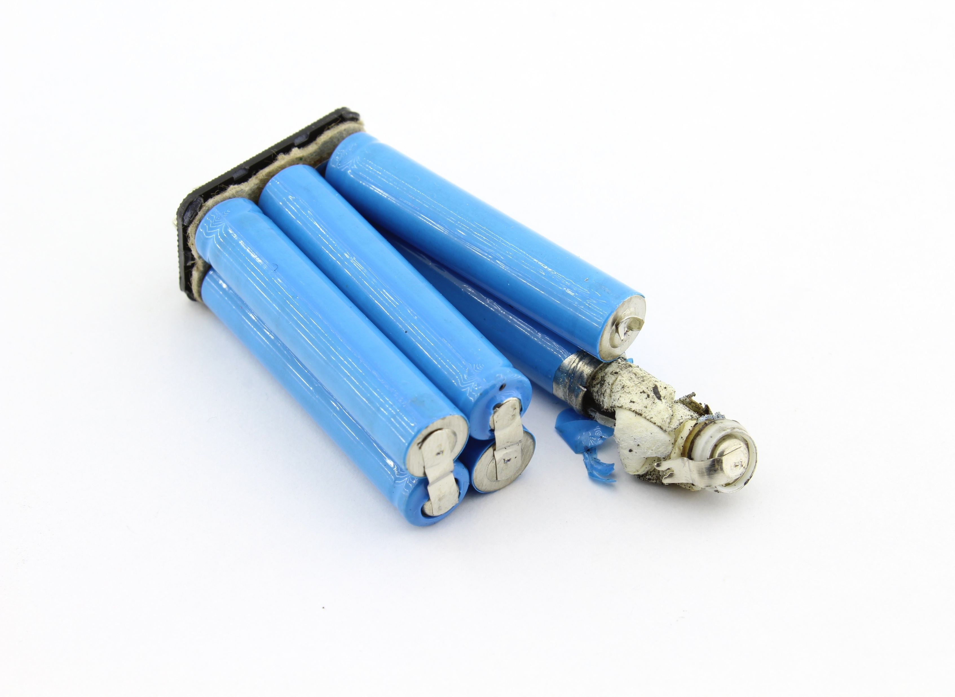

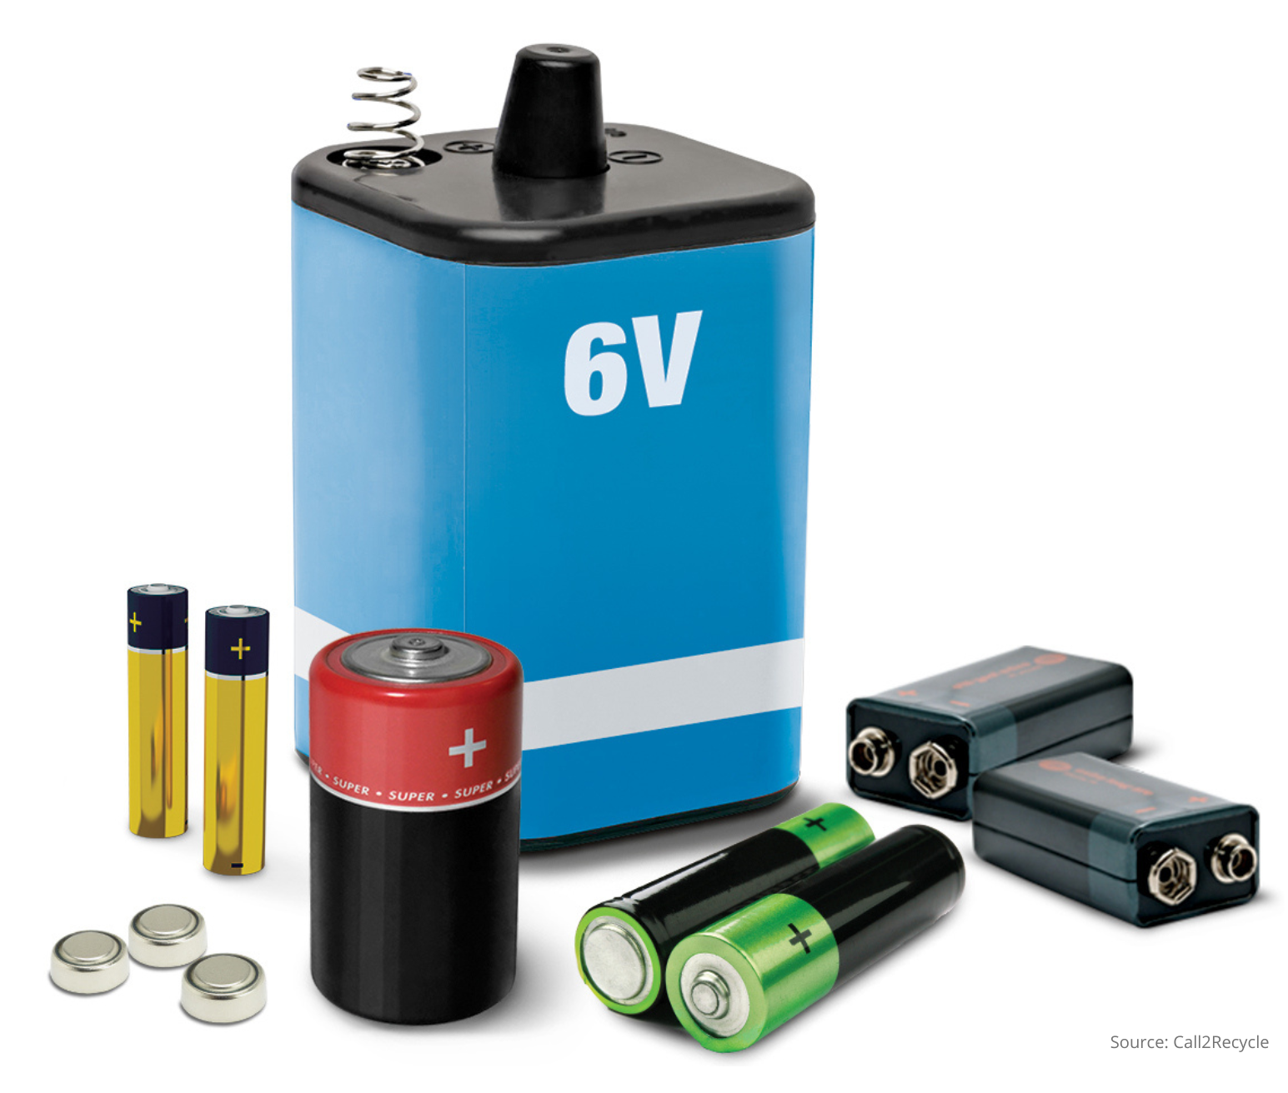
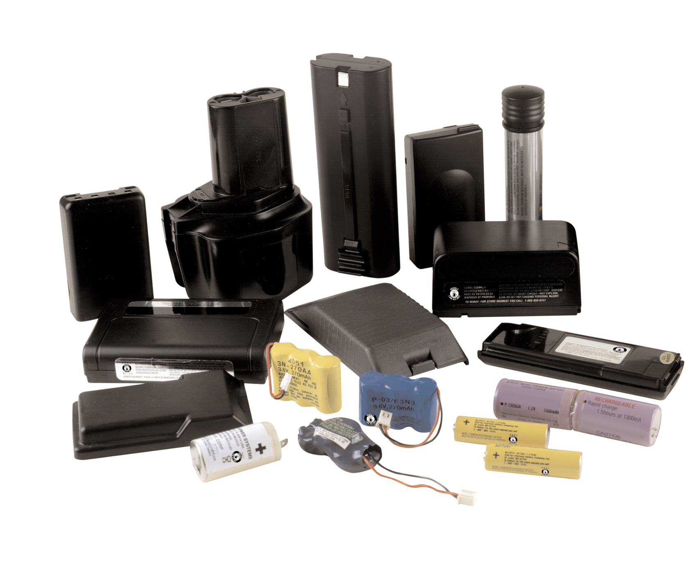
Battery 101
Common terms used throughout the course:
 | Damaged, Defective, Recalled (DDR) | Batteries showing signs of swelling, leaking, burn marks, or part of a recall - require special handling, labeling, and packaging.
 | Transport Canada Equivalency Certificate | This certificate exempts Call2Recycle Canada and any participating battery program collector from certain requirements under TDG regulations to handle, offer for transport or transport by road or railway vehicle, or by vessel in Canada.
 | Primary (Single-Use) Battery | One-time use, they cannot be recharged. Common chemistries include Alkaline, Lithium metal, and Zinc-carbon (comes in various shapes and sizes like AA, AAA, 9V, C- and D-cell, and Button cell).
 | Rechargeable Battery | Can be recharged and reused multiple times. Common chemistries include Nickel Cadmium (Ni-Cd), Nickel Metal Hydride (Ni-MH), Lithium Ion (Li-Ion), Small Sealed Lead Acid (SSLA/Pb).
Notes:
Let’s start with some battery basics and review a few common terms you’ll see throughout the training. Take a moment to get familiar with them.

Slide 6
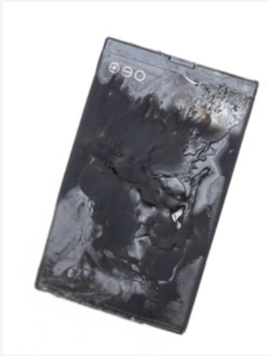
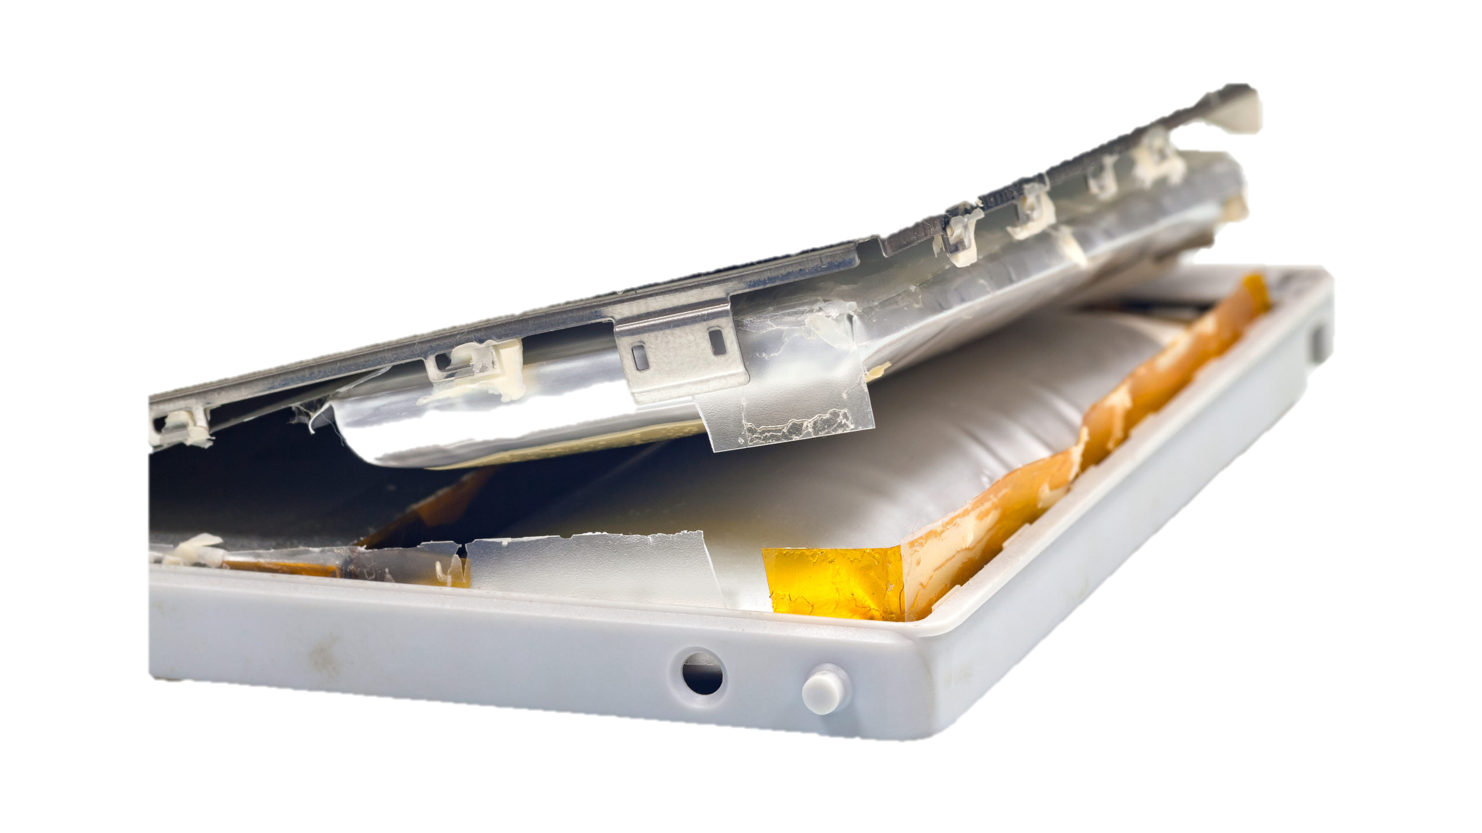
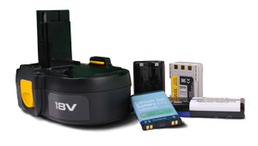

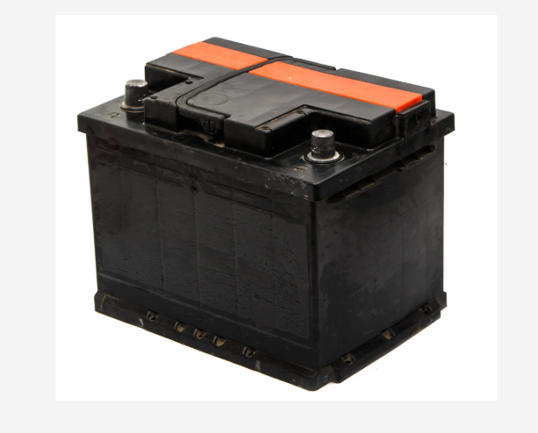
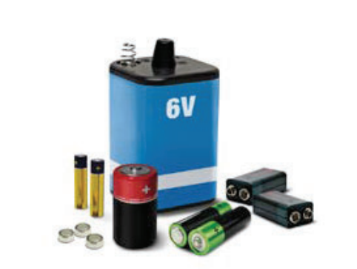
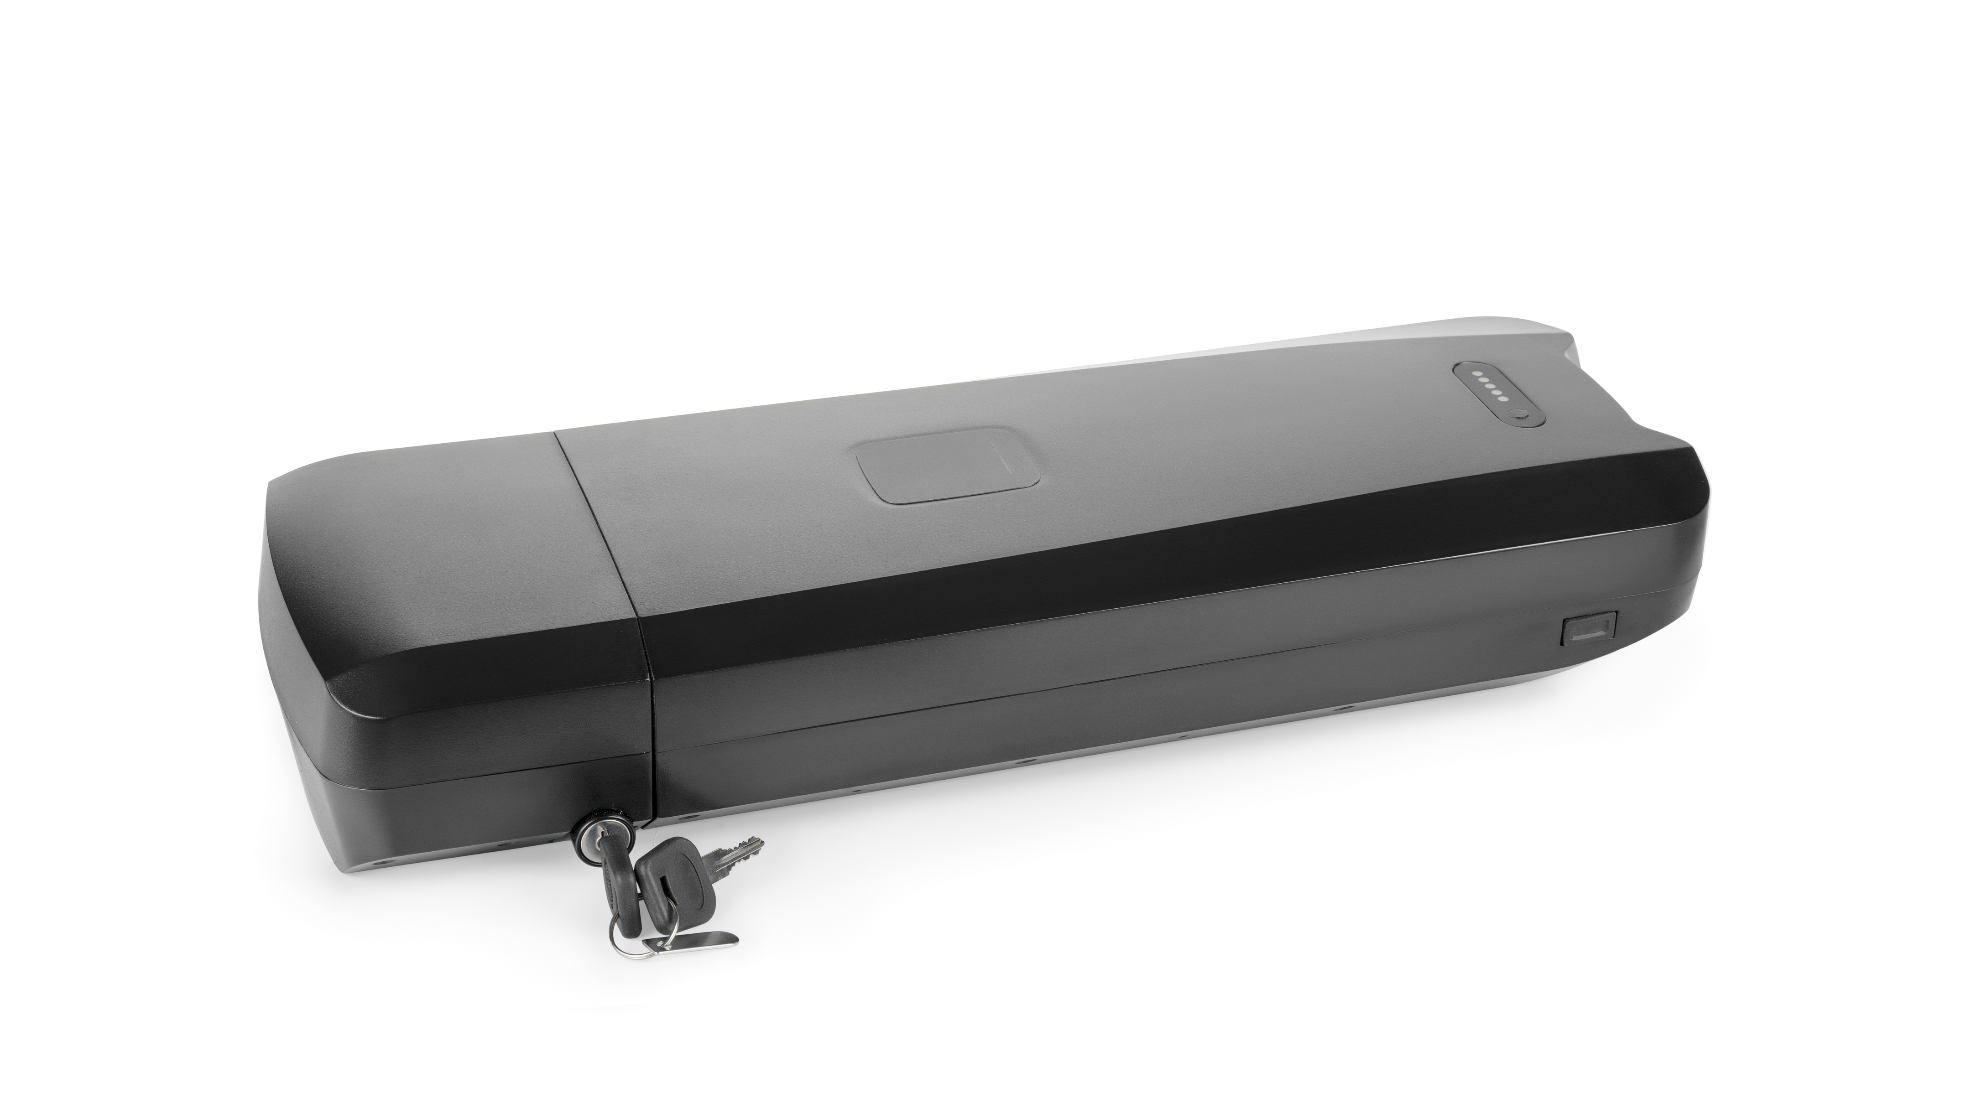
Materials Accepted
Call2Recycle’s consumer battery program – Recycle Your Batteries, Canada! – is designed to handle single-use and rechargeable batteries up to 5 kgs. For other types of battery and battery-containing devices, Call2Recycle operates additional programs including Recycle Your Vapes in Quebec, EV Battery Services across Canada and more. Details can be found on our website here.
Accepted
NOT Accepted
Rechargeable Batteries (up to 5 kgs)
  Lithium Ion (Li-Ion)
  Nickel Cadmium (Ni-Cd)
  Nickel Metal Hydride (Ni-MH)
  Nickel Zinc (Ni-Zn)
  Small Sealed Lead Acid (SSLA/Pb)
Single-Use Batteries
  Alkaline (AA, AAA, 6V, 9V, C, D)
  Button and Coin Cell
  Lithium Primary
Damaged or Defective Lithium or Lithium Ion Batteries
(See DDR section)
Batteries Part of a Recall
(See DDR section)
Wet-Cell Batteries (i.e. car batteries)
No Batteries over 5 kgs
No E-Mobility Batteries (i.e., e-scooter, hoverboard, e-bike)*
*E-mobility batteries are accepted in bulk containers in some jurisdictions. Consult your Account Manager to confirm if you are eligible.
Notes:
Knowing what IS and ISN’T accepted in our program is key to a safe and smooth process. We’ve clearly outlined these categories to eliminate any confusion.

Slide 7
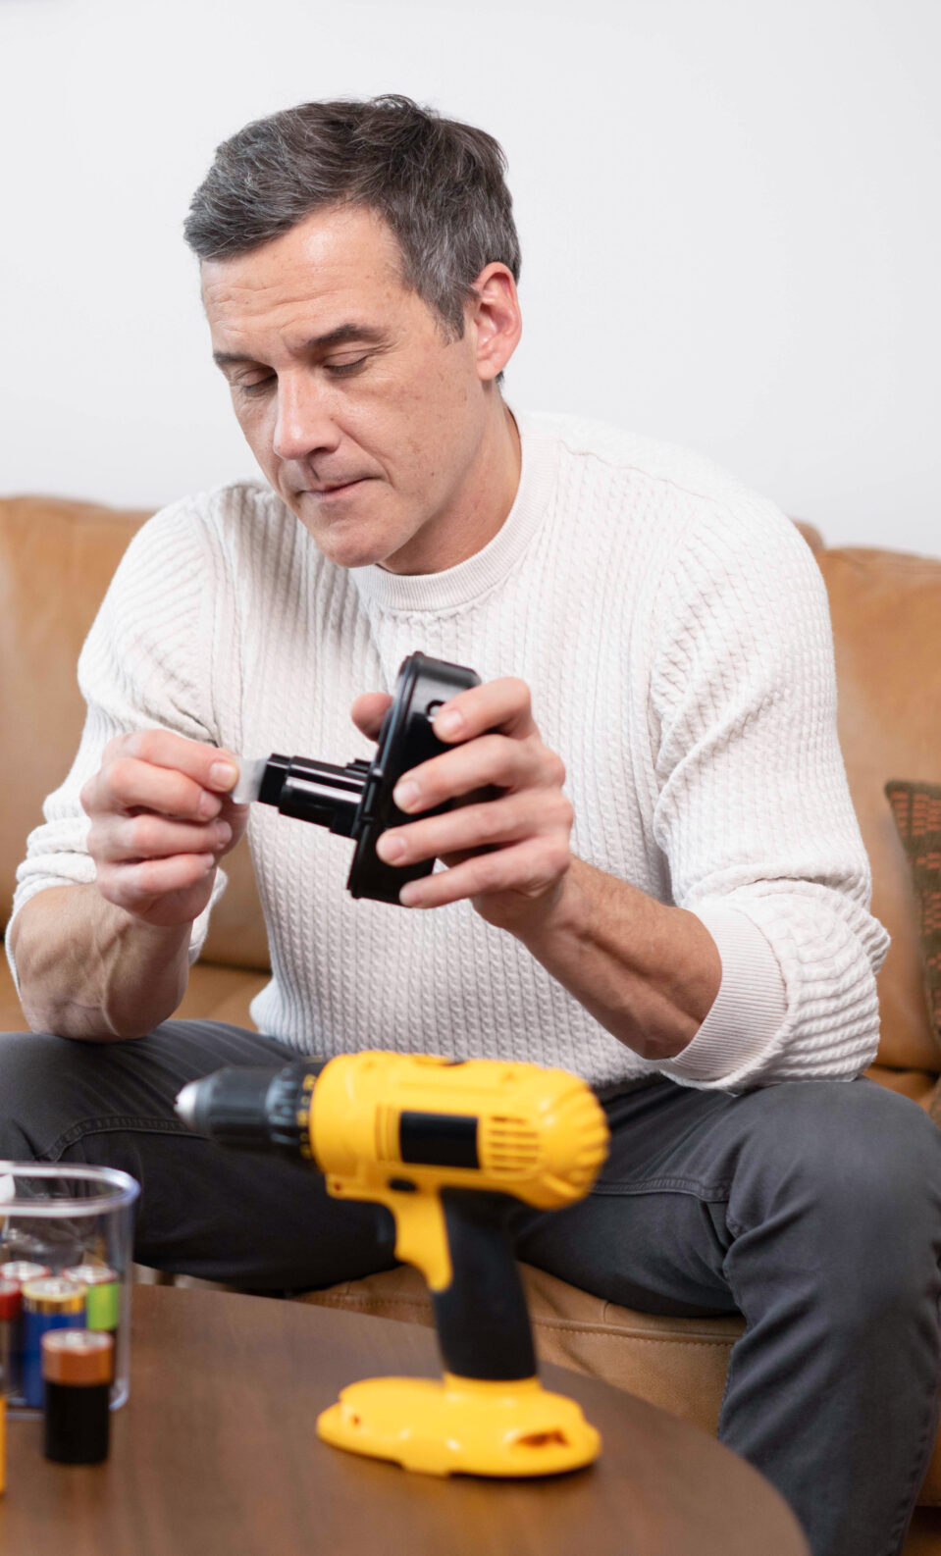
Terminal Protection
Notes:
Now let’s dive into the importance of terminal protection.

Slide 8
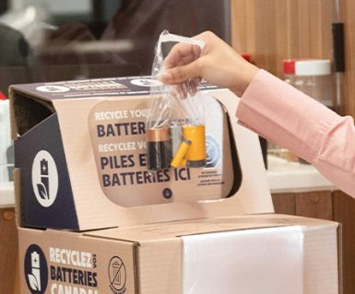
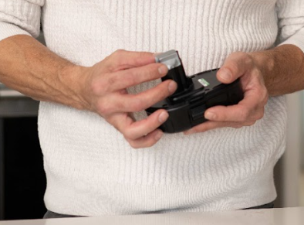
Safety First!
Many batteries hold a residual charge even when they appear dead. If that battery comes into contact with other batteries or metal, a short circuit can occur, causing a thermal event (or fire).
All battery shipments in Call2Recycle’s consumer battery program – Recycle Your Batteries, Canada! – must follow Transport Canada regulations, including protecting terminals of certain battery types.
For lithium-ion, small sealed lead acid, or lithium primary and alkaline batteries that are 12V or more, there are two options for terminal protection: Bagging or Taping.
Notes:
Protection is key. EVERY battery shipment in our Recycle Your Batteries, Canada! program must follow Transport Canada regulations, including protecting the terminals of certain battery types to prevent safety incidents.

Slide 9



Terminal Protection
Transport Canada requires terminal protection (bagging or taping) for the following battery types:
TERMINAL PROTECTION
REQUIRED
TERMINAL PROTECTION
NOT REQUIRED
Rechargeable Batteries
  ALL Lithium Ion (Li-Ion)
  ALL Small Sealed Lead Acid (SSLA/Pb)
Primary Batteries
  ALL Lithium
  Button Coin Cell
  Alkaline (over 12V)
Rechargeable Batteries
  Nickel Cadmium (Ni-Cd)
  Nickel Metal Hydride (Ni-MH)
  Nickel Zinc (Ni-Zn)
Primary Batteries
  Alkaline (under 12V)
  Carbon Zinc
Not sure if the battery requires terminal protection? Play it safe and bag it!
Notes:
Based on Transportation of dangerous goods regulations, Transport Canada requires terminal protection for certain battery types. Lithium-ion, small sealed lead acid, lithium primary, including button coin cells and alkaline batteries over 12 volts. Each battery must either be bagged or have non-conductive tape on the terminal ends. If you don’t know the battery type, play it safe and bag or tape each battery.

Slide 10
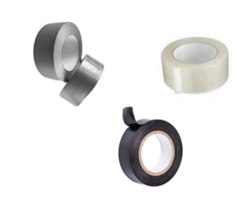

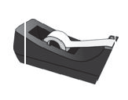
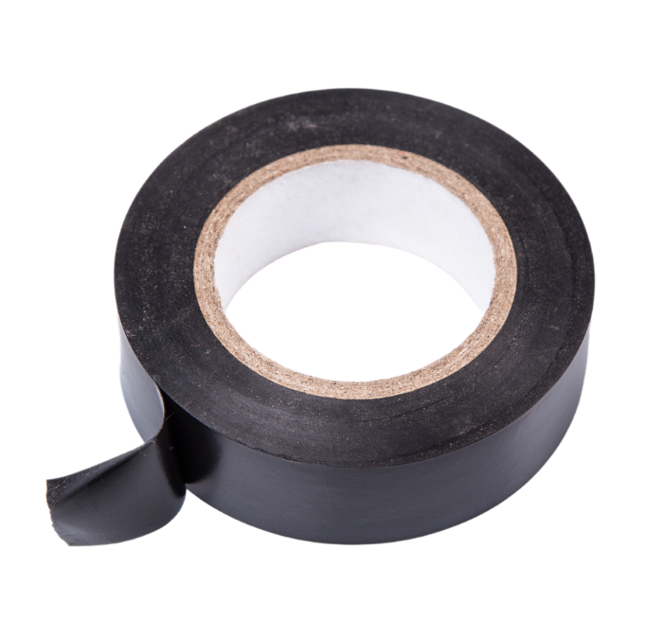






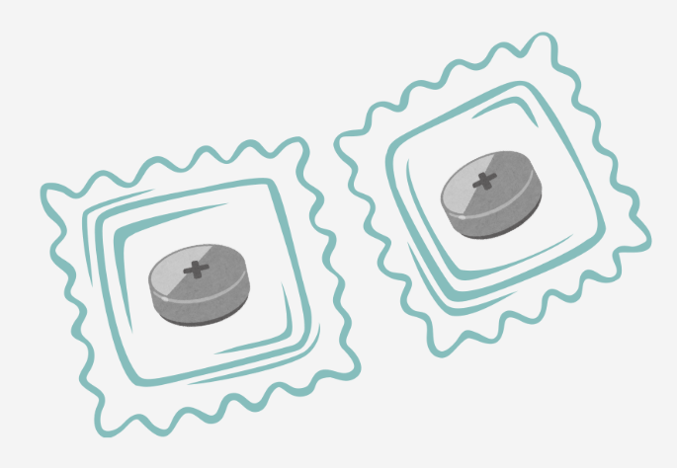
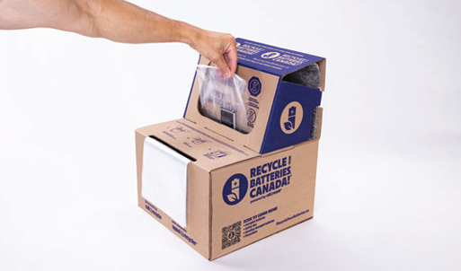
Option 1: Tape Terminals
ONLY USE
DO NOT USE
Non-conductive tape
X
X
X
Clear Packing
Duct tape
Electrical tape
Painter’s tape
Masking tape
Scotch tape
Apply tape to cover the positive (raised or exposed) terminal. Avoid covering the battery chemistry name.
For coin or button cells, make a “battery ravioli” by sealing them between two pieces of tape (sticky sides in).
Gently drop taped battery(ies) into collection container (box, Smart Container, or drum).
Not sure if the battery requires terminal protection? Play it safe and bag it!
Notes:
Reduce your risk and prevent safety incidents by protecting every battery. Apply tape to cover the positive terminal, then gently drop it into your collection container. For button cells, make a “battery ravioli.”

Slide 11

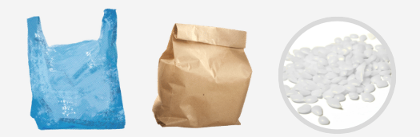

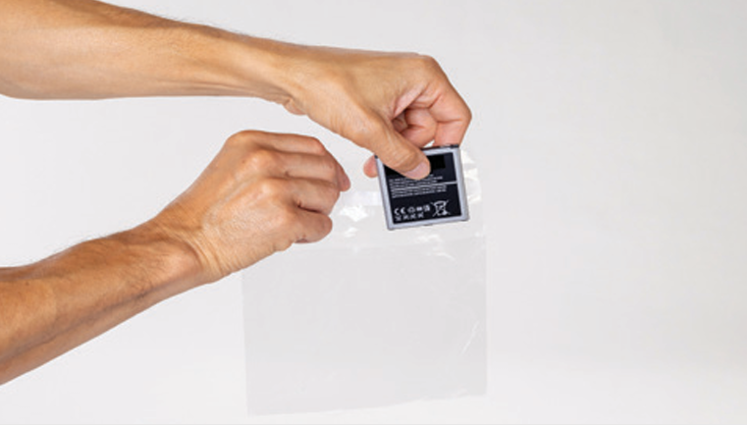
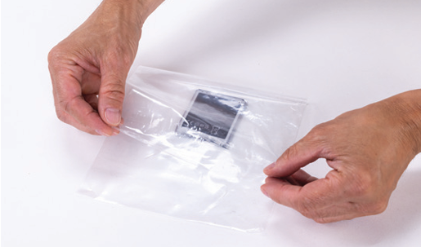
Option 2: Bag and Seal
ONLY USE CLEAR PLASTIC BAGS
DO NOT USE
X
X
X
Paraffin or other dipping products
Call2Recycle-provided
Produce
Ziploc®
Colored or Grocery bags
Paper bags
Place each required battery in an appropriately sized bag. Don’t put multiple batteries in a bag.
Place the battery in the bag and seal/zip/tie to secure contents.
Gently drop bagged battery into collection container (box, drum, or Smart Container).
Not sure if the battery requires terminal protection? Play it safe and bag it!
Notes:
A second option is to place each required battery type into a bag, seal it and then gently drop it. Make sure you don’t put multiple batteries in the same bag.

Slide 12


Daily Safety Checklist
The Recycle Your Batteries, Canada! program is designed to make battery collection and recycling simple and safe.
Collection partners still have important daily responsibilities:
  No Damaged Containers: Ensure containers are not damaged.
  Container Usage: Ensure containers are being used as intended, including liners are intact, labels in place, etc.
  Container Placement: Ensure containers are placed in a safe place, including in a cool area away from heat sources.
  No Loose Batteries: Ensure no loose batteries are around the container.
  Terminal Protection: Ensure all required batteries are bagged or taped.
  No DDR Batteries: Confirm Damaged, Defective, or Recalled (DDR) batteries are not inside the drums or collection boxes.
  No Trash or Foreign Items: Only accepted batteries are inside the collection container.
See the “DDR” section for further instructions.
Notes:
Finally, as a collection partner, it’s important to check your battery collection container every day. These quick daily checks help keep you and the program safe.

Slide 13
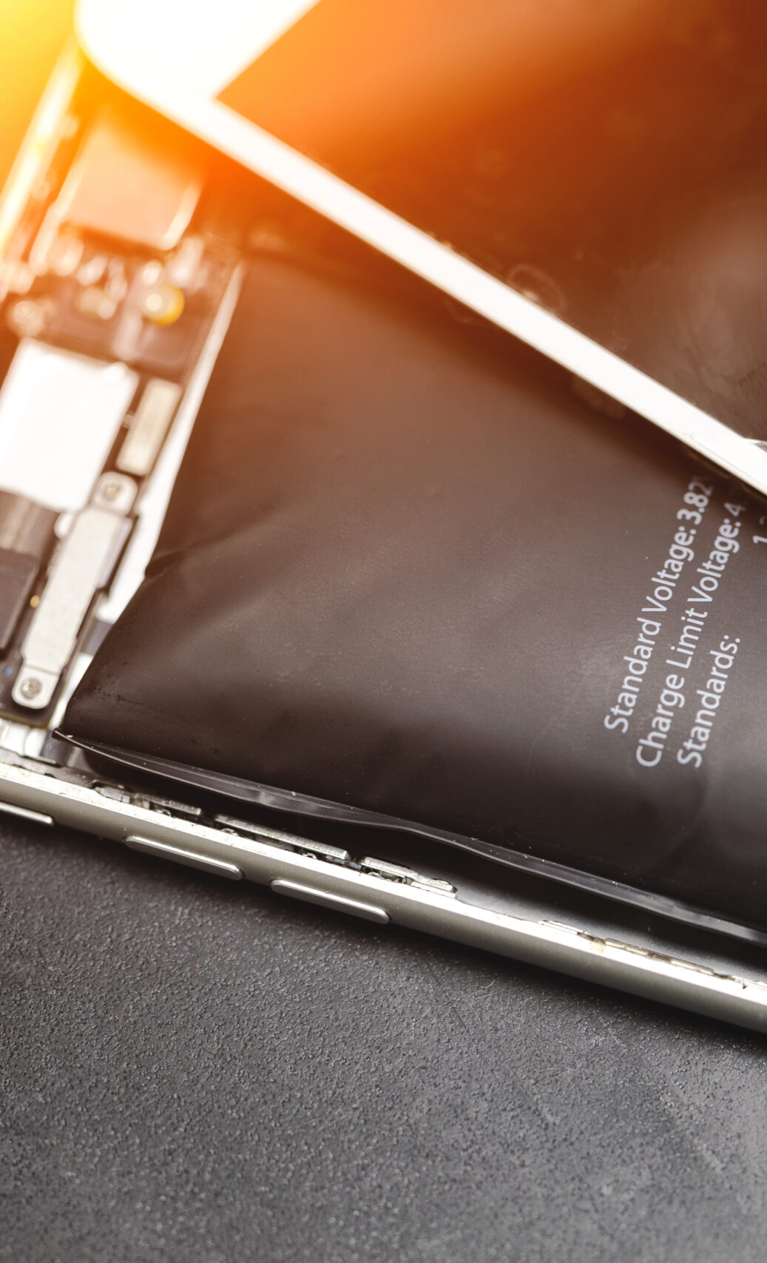
Damaged / Defective / Recalled (DDR) Batteries
Notes:
Now that we’ve covered the importance of Terminal Protection, let’s dive into Damaged, Defective, or Recalled batteries, known as DDR batteries.

Slide 14

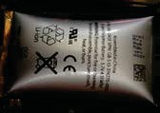
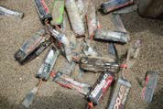
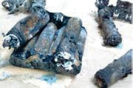
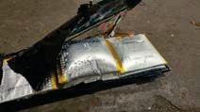
Damaged / Defective / Recalled (DDR): Special Handling
Lithium-ion or lithium batteries that are swollen, smoking, leaking, overheating, or are part of a recall are considered DDR.
NEVER place DDR batteries in collection boxes, Smart Containers, drums, blue bins, or garbage.
They require special packaging for shipping. Contact Call2Recycle or order DDR kits on our Order portal if you don’t have one on hand.
Notes:
DDR batteries are lithium-ion or lithium-metal batteries that are swollen, smoking, leaking, overheating or are part of a recall.
They must NEVER be placed in ANY Recycle Your Batteries, Canada! collection container.
Instead, they must be packaged and shipped in a special DDR kit, available through our Order portal.

Slide 15


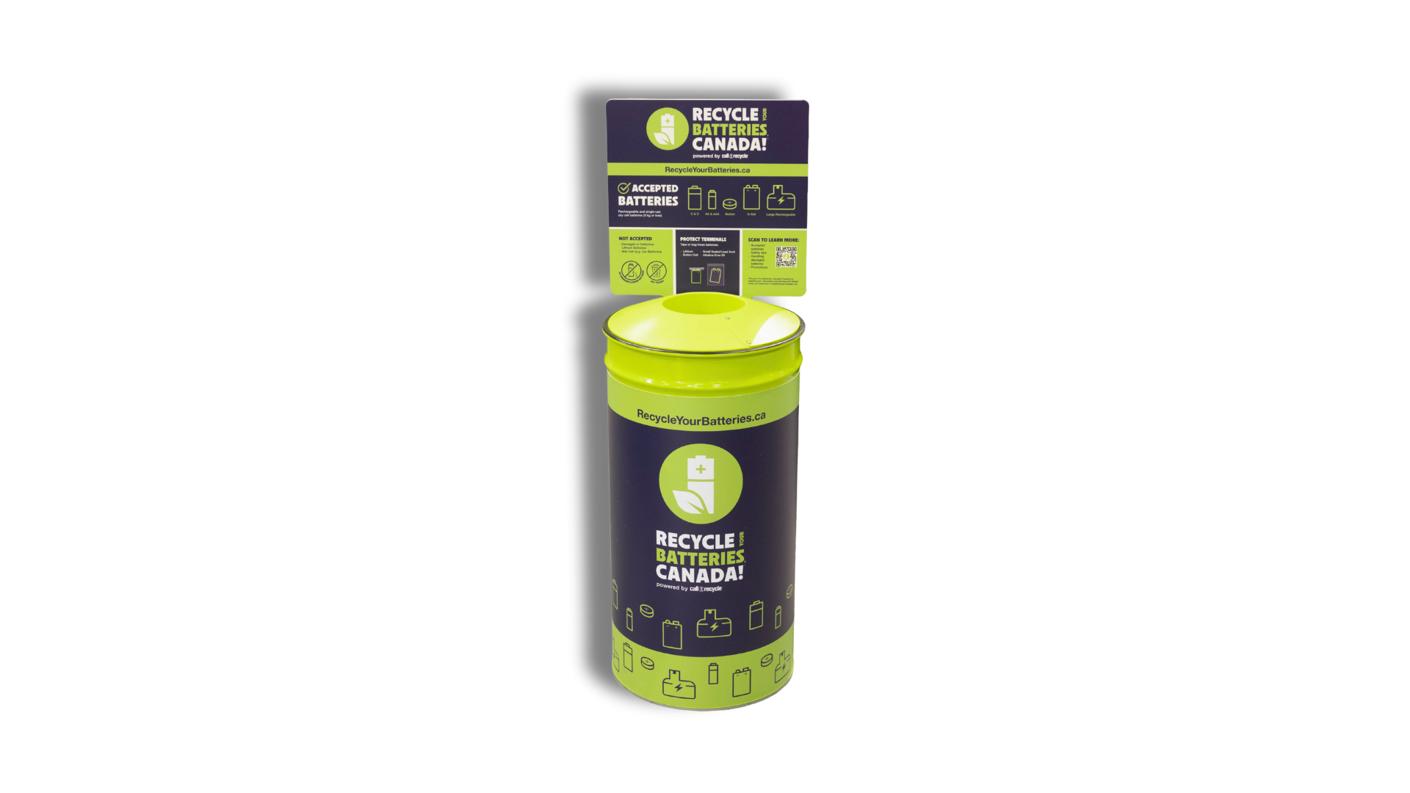
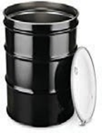
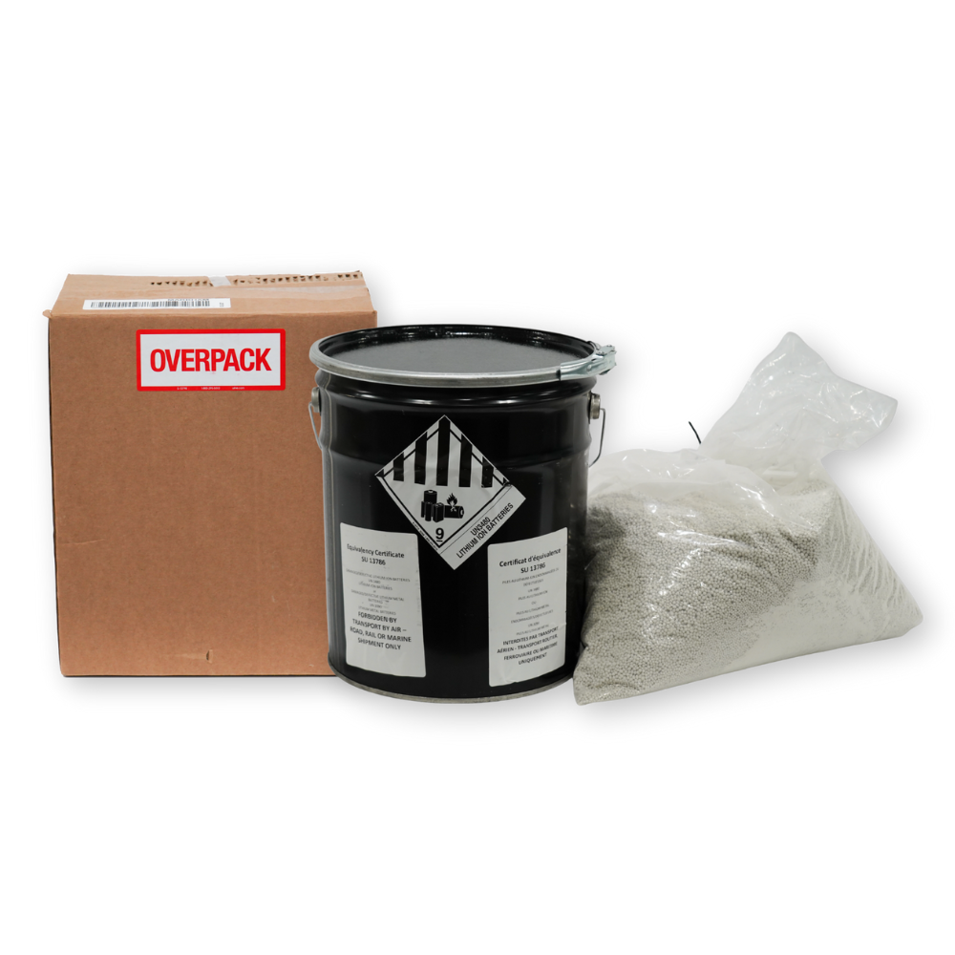
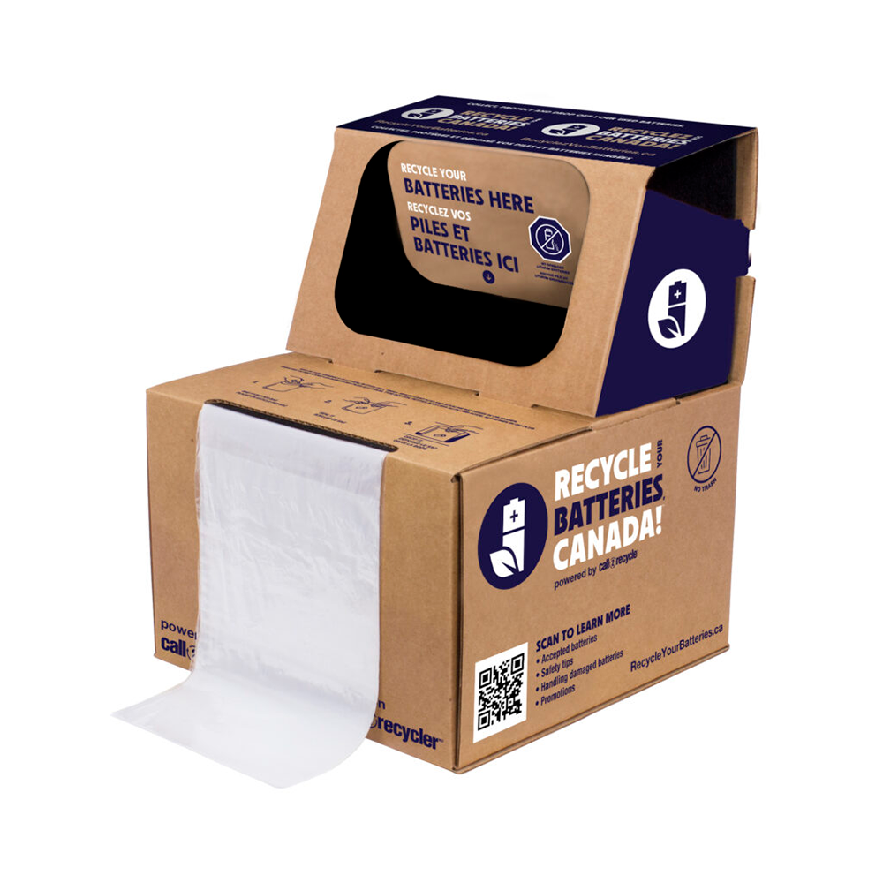
Damaged / Defective / Recalled (DDR): Special Handling
1
Identify Battery Chemistry: Look on the battery label or outer packaging to find the battery’s chemistry.
Is the Damaged / Defective battery
Alkaline
Nickel Cadmium
(Ni-Cd)
Small Sealed Lead Acid (SSLA/Pb)
Nickel Metal Hydride
(Ni-MH)
Lithium metal
Lithium-ion
Place in a clear plastic bag and deposit directly into a Call2Recycle-approved collection container.
Damaged lithium metal or lithium-ion batteries MUST go into a special DDR container.
See Step 2.
Notes:
Step one is identifying the chemistry. Check the label or packaging. If it’s lithium-ion or lithium-metal and shows signs of damage, it needs special handling. Other chemistries, even if they are showing signs of corrosion or damage, can go in your regular collection container.

Slide 16

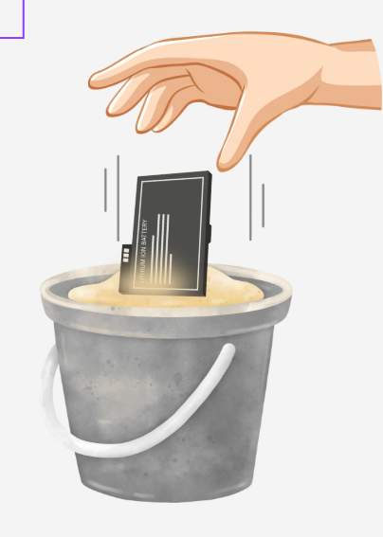
Damaged / Defective / Recalled (DDR): Special Handling
Safely Store
Place DDR batteries in non-flammable material, such as sand or baking soda, while you arrange for safe drop-off.
Place DDR batteries in a metal container that is lined.
Store the container away from heat, sparks, and flammable items.
DO NOT place batteries in the garbage,
blue bin, or ANY Recycle Your Batteries, Canada! collection container provided by Call2Recycle!
Notes:
Step two is safe storage. Place DDR batteries in non-flammable material like sand or baking soda inside a lined metal container, away from heat, until your DDR kit arrives.

Slide 17

Damaged / Defective / Recalled (DDR): Special Handling
Check for Recalls
Visit Health Canada’s Consumer Product Safety website or the manufacturer’s website to see if the battery is part of a recall.
Is the battery part
of a recall?
YES
NO
Follow the recall instructions provided.
Proceed to DDR Step 4.
DO NOT place batteries in the garbage, blue bin, or ANY Call2Recycle collection container!
Notes:
Step three: check for recalls. Visit Health Canada’s Consumer Product Safety website. If recalled, follow the instructions given.

Slide 18
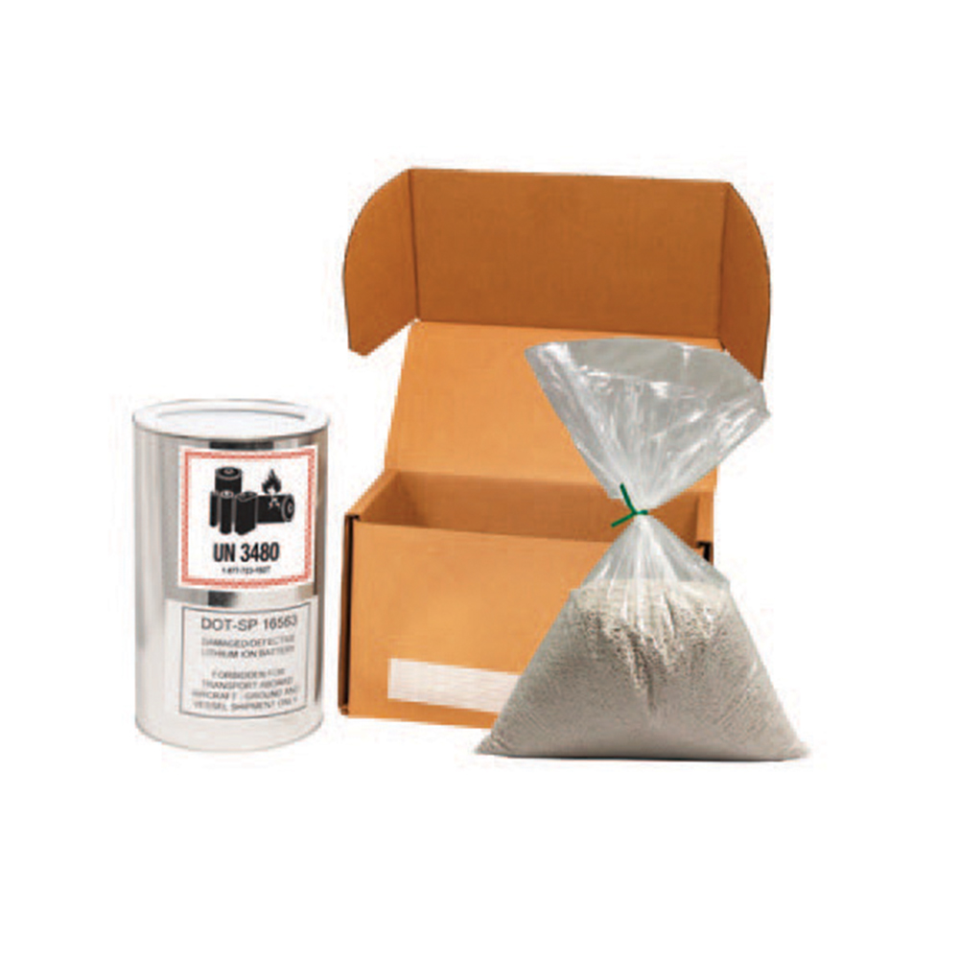


Damaged / Defective / Recalled (DDR): Special Handling
Damaged lithium metal or lithium-ion batteries must be placed in special DDR containers for shipping and disposal.
Arrange Safe Drop Off
Use the right kit: Call2Recycle provides specially-protected and permitted DDR kits in multiple sizes.
Package safely: Place DDR batteries into a Call2Recycle-provided DDR kit and follow the instructions for safe, compliant packaging and shipping to the recycler.
Need a kit? If you don’t have one, order a DDR kit through our Order portal or contact Call2Recycle Customer Service: customerservice@call2recycle.ca or by phone at 1.888.224.9764.
DO NOT place batteries in the garbage, blue bin, or ANY Call2Recycle standard collection container!
Notes:
And as the final step, arrange for safe drop-off. Order a DDR kit (available in multiple sizes) through our Order portal or contact our Customer Service team.
Remember: damaged or recalled lithium-ion or lithium-metal batteries must NEVER be placed in any collection container.

Slide 19
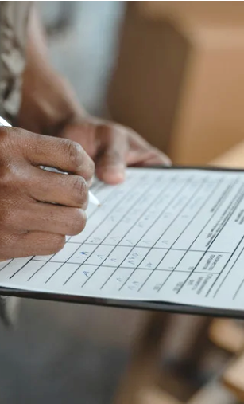
Safe Shipping
Notes:
We’ve covered terminal protection and DDR batteries. Now, our final topic for reducing risk and staying safe is Safe Shipping.

Slide 20
Approved Containers
It is important to inspect and confirm that you only use the approved collection containers listed below before shipping your materials.
Boxes
Smart Containers
Bulk Shipping
If you collect in standard boxes, ensure you only use boxes provided by Call2Recycle. Ensure boxes are stored in a cool, dry place and inspected daily.
Do not place Damaged, Defective, or Recalled (DDR) batteries in any standard Call2Recycle container.
Call2Recycle accepts batteries returned in:
UN-rated steel drum (Rated to Packaging group 2) with plastic liner.
Drums must have an open head with lever locking ring lid and be stored in a cool, dry place.
For detailed shipping instructions for all collection containers, visit our shipping page.
Notes:
Always use one of the 3 approved collection containers:
Standard collection boxes provided by Call2Recycle
Smart containers with remote monitoring capabilities also provided by Call2Recycle
Or, UN-rated steel drums.
Be sure to perform daily checks to inspect your approved collection container.

Slide 21
Safe Shipping
For all approved containers, it is important to follow the guidelines below in accordance with Transport Canada requirements:
Cells and batteries must be packed in accordance with the following:
  Metal Drums.
  Packagings must conform to the packing group II performance level.
  Metal packagings must be fitted with an electrically non-conducive lining material (i.e., plastics) of adequate strength for the intended use.
Protection against short circuits and the dangerous evolution of heat includes, but is not limited to:
  Individual protection of the battery terminals.
  Inner packaging to prevent contact between cells and batteries.
  The use of an electrically non-conductive and non-combustible cushioning material to fill empty space between the cells or batteries in the packaging.
Cells and batteries must be secured within the outer packaging to prevent excessive movement during transport (i.e., by using a non-combustible and electrically non-conductive cushioning material or through the use of a tightly closed plastics bag).
For detailed shipping instructions for all collection containers, visit our shipping page.
Notes:
When your container is full and you’re ready to ship, remember to follow these 3 guidelines in accordance with Transport Canada requirements.

Slide 22
How to Ship: Inspect then Ship!
Whatever approved container you collect and ship in (standard collection boxes, Smart Containers, Drums, or boxes on a pallet), the goal is the same: ship it safely!
Batteries are Terminally Protected
No DDR Batteries
No Trash or Foreign Objects
Check All Containers
Ensure all required batteries collected have been properly bagged or taped to protect terminals.
Do not place Damaged, Defective, or Recalled (DDR) batteries in any standard Call2Recycle container.
Confirm only accepted batteries are inside the container.
All containers should have proper labels, UN markings, sealed correctly and include accurate shipping paperwork.
For detailed shipping instructions for all collection containers, visit our shipping page.
Notes:
Once you’ve checked your container, you’re ready to ship. Always follow these 4 steps before shipping:
1: Ensure batteries are terminally protected.
2: Make sure no Damaged, Defective or Recalled Lithium-ion or Lithium-metal batteries are in your container.
3: Confirm there is no garbage or foreign objects in your container.
4: Check to make sure all containers have correct labels and UN markings, are sealed correctly and have accurate shipping paperwork.

Slide 23
Marketing Support &
Program Resources
Notes:
Here’s a quick look at Marketing and Program Resources available to you.

Slide 24
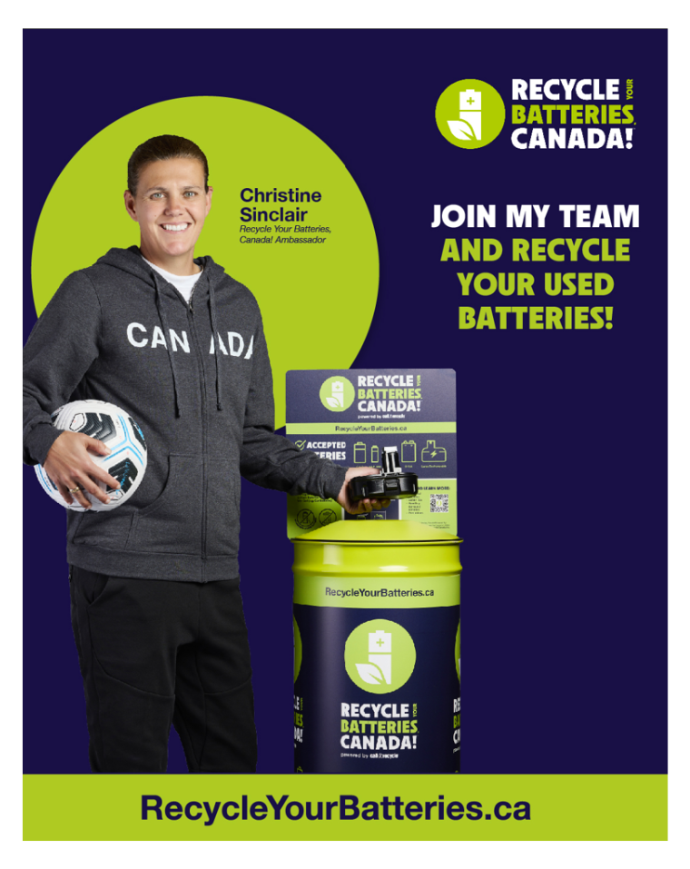
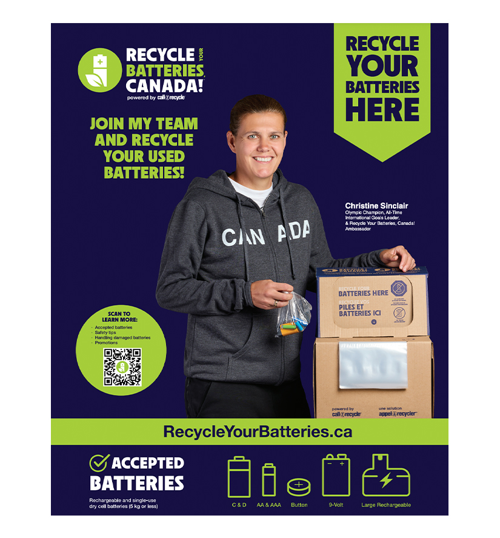
Education & Awareness: Toolkits & Resources
Call2Recycle executes advertising campaigns to educate consumers about why, when, and where to recycle their batteries through the
Recycle Your Batteries, Canada! program.
Posters and social media graphics are also available to you for promoting your participation in the program.
Access these resources on our website here.
Notes:
To help educate your customers, we offer a wealth of education and awareness resources, which are all available on our website.

Slide 25
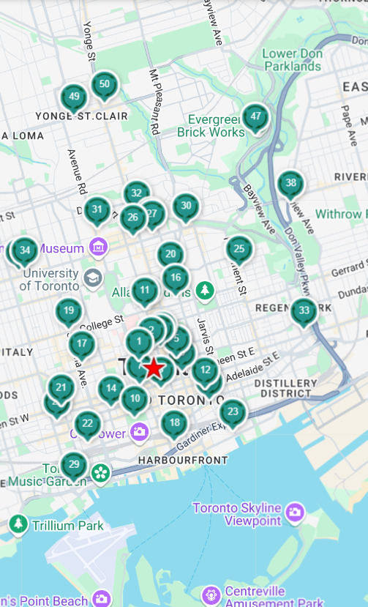
Drop-Off Locator
As a collection site, you can choose to be public (consumer drop-off) or private (internal use only).
Public collection sites are listed on our Drop-off locator.
Consumers can find their closest drop-off location by entering their postal code.
Locations become inactive and are removed from public listing if no activity occurs (batteries shipped or boxes ordered) within 12 months.
To re-activate your location, please contact customer service.
Notes:
Another great tool is our Recycle Your Batteries, Canada! online drop-off locator. Adding your location helps customers and residents know you offer battery recycling services.

Slide 26

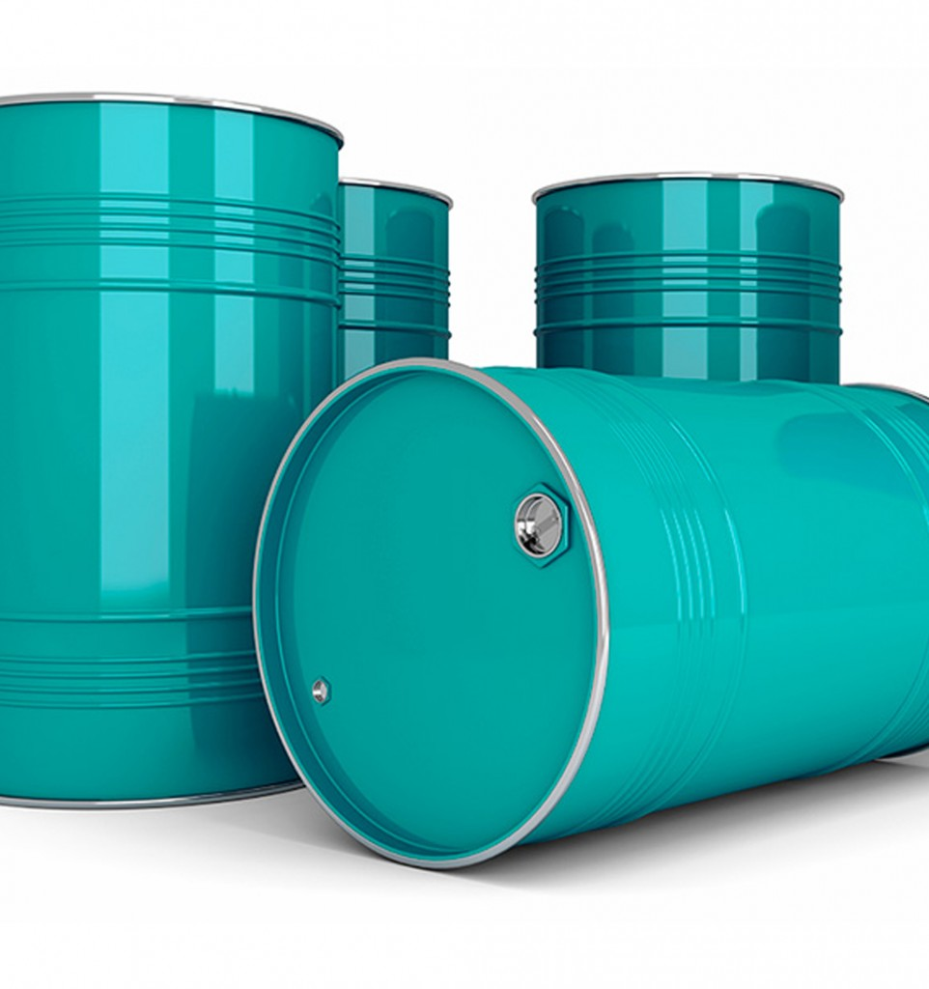
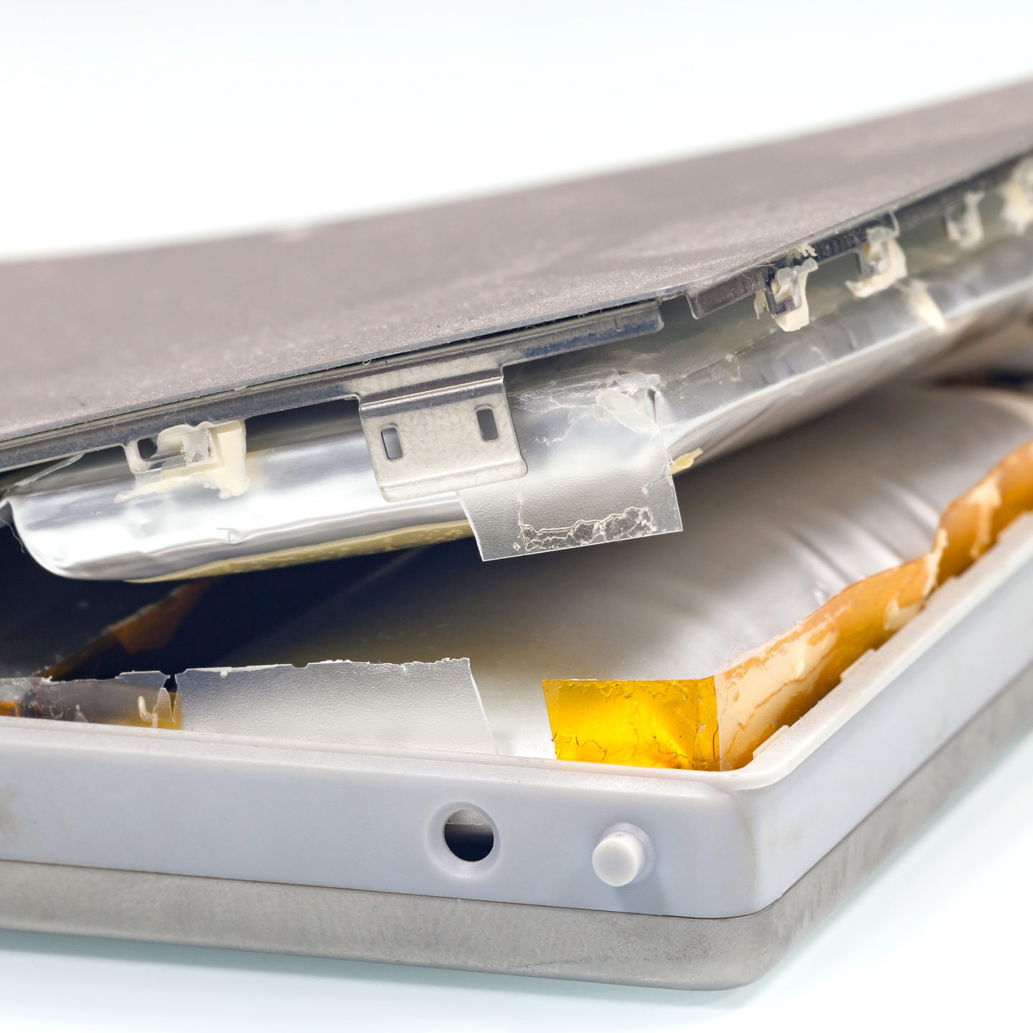
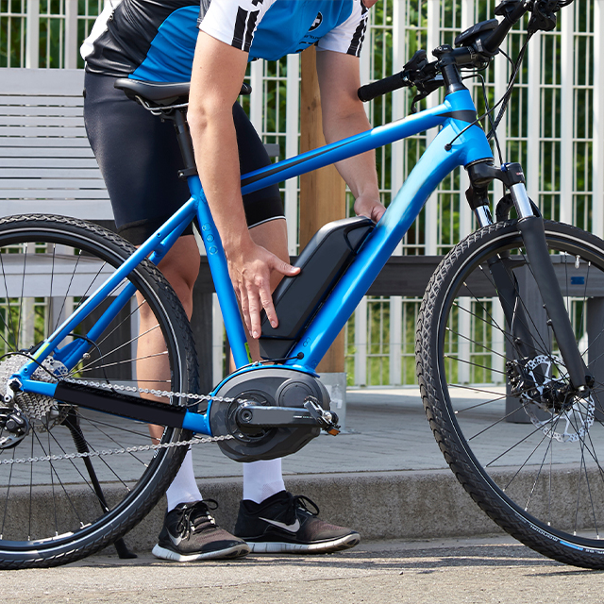
Quick Reference: Resources & Support
Program Questions
Box Program
Bulk Program
DDR Batteries
E-Mobility Program
Website or Contact Us
Resources
Resources
Resources
Resources
Web: call2recycle.ca/safety
Email: info@call2recycle.ca
Phone: 1-888-224-9764
Re-Order Collection Materials
Terminal Protection Guide
How to Ship
Receiving Materials Tip Sheet
Pre-Shipping Tip Sheet
Shipping Tip Sheet
Handling Instructions
DDR Kit Packaging Guide
Order a DDR kit
Program Overview
E-Mobility Box Kit Guidelines
E-Mobility DDR Guidelines
Notes:
And finally, to wrap up your training, here’s a quick reference guide with all the resources and support available to you.
Have additional questions?
Our team is here to support you every step of the way, so please reach out anytime.

Slide 27

Thank you for your continued commitment to safe & responsible battery collection & recycling!
100 Sheppard Ave East, Suite 800
Toronto ON M2N 6N5

